Slide 1
Hand Gesture Recognition 張 海斌

Slide 2
Outline
0. Background
Previous Work
2. ResNet-50 Model
3. Experiment
4. Future Work

Slide 3
Background
Hand gesture is not only a way used among people who have difficulty in speaking or hearing, but more and more a new way for interaction with machine and computer. Hand recognition enables humans to communicate with the machine and interact naturally without any mechanical devices.
Application :
Human Machine Interaction(HMI)
Online Education
Virtual Reality

Slide 4
Outline
0. Background
Previous Work
2. ResNet-50 Model
3. Experiment
4. Future Work

Slide 5
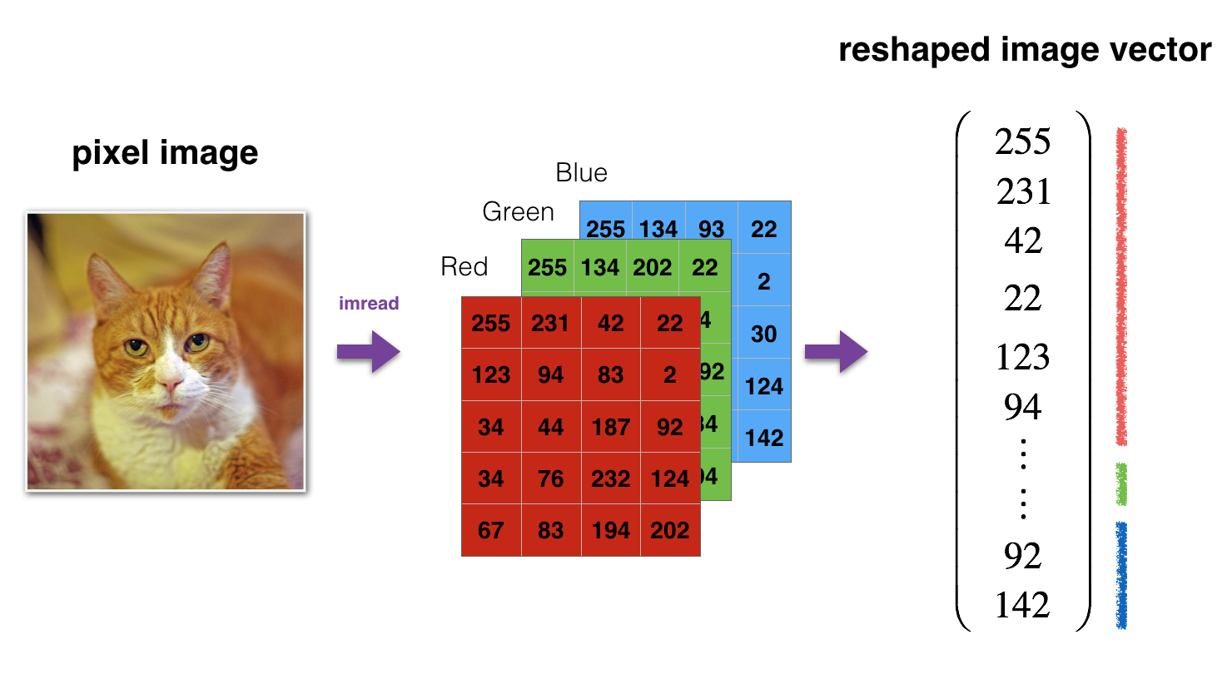
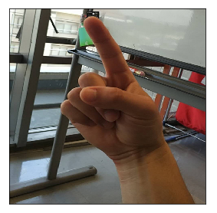
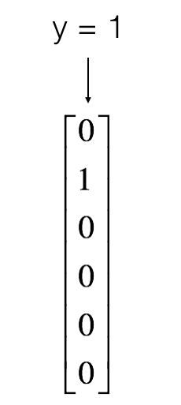
Dataset
Input
Shape: (12288, 1080)
12,288 equals 64×64×3, size of one reshaped image vector.
1080 is sample number.
Original vector: (64, 64, 3)
Reshaped vector: (12288,1)
Output
Shape: (6, 1080)
6 is output dimension representing numbers from 0 to 5.
1080 is sample number.

Slide 6
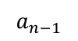
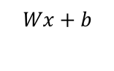
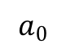
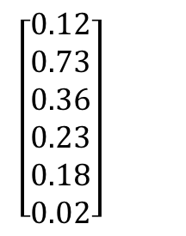
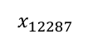
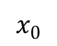
Neural network based method
The second dimension has the largest probability.
$$\left[\begin{matrix}0.12 \\ 0.73 \\ 0.36 \\ 0.23 \\ 0.18 \\ 0.02\end{matrix}\right]$$
It’s one
$$x_{0}$$
$$a_{0}$$
Define the neural network structure.
Initialize the model's parameters
Loop:
- Implement forward propagation
- Compute loss
- Implement backward propagation to get the gradients
- Update parameters (gradient descent)
…
$$Wx+b$$
…
…
$$Wx+b$$
Sigmax
0.73
ReLU
…
…
$$x_{12287}$$
$$a_{n−1}$$

Slide 7
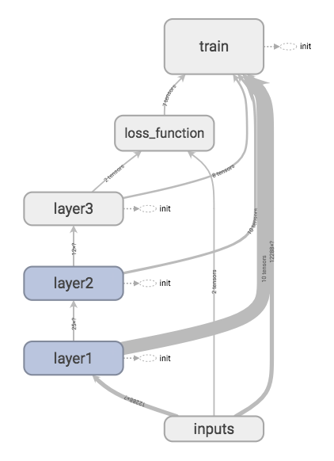
Neural network models
Three-layer Full-connected neural network
layer1
layer2
layer3
FC
Relu
FC
Relu
FC
Softmax
Three-layer Convolutional neural network:
layer1
layer2
layer3
Conv2D
Relu
Max Pooling
Conv2D
Relu
Max Pooling
Flatten
FC

Slide 8
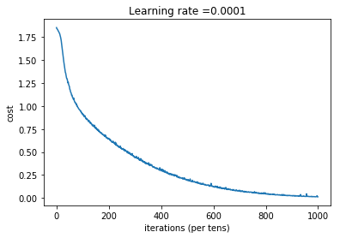
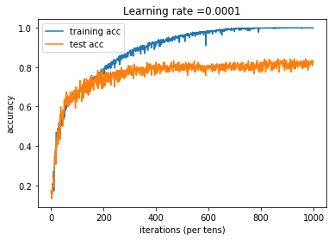
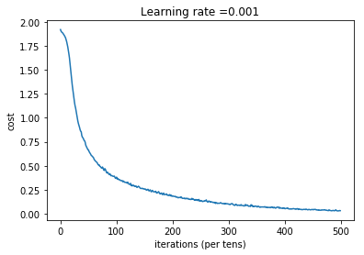
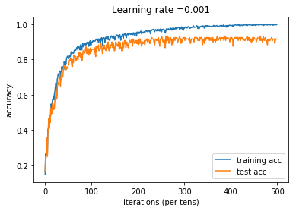
evaluation
Full-connected neural network
0.001
0.001
Problem Point
Improve test accuracy
Trying deeper network model
Convolutional neural network

Slide 9
Outline
0. Background
Previous Work
2. ResNet-50 Model
3. Experiment
4. Future Work

Slide 10
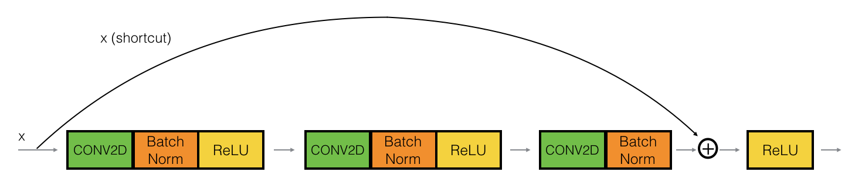
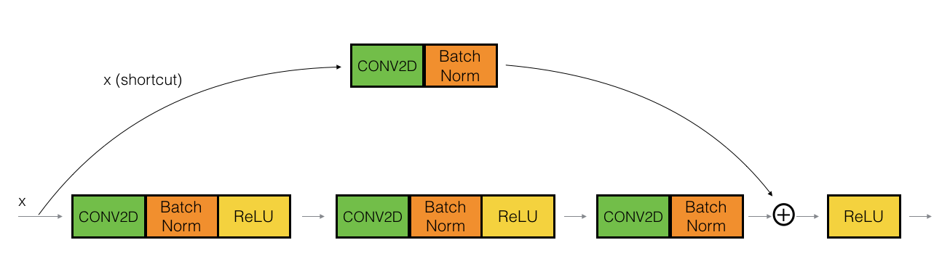
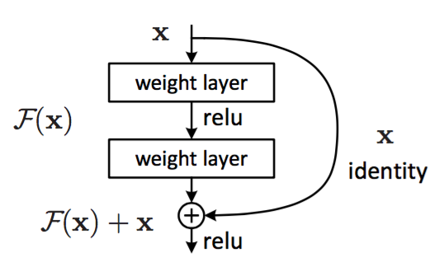
ResNet-50 Model：
The formulation of F(x)+x can be realized by feedforward neural networks with “shortcut connections”. Shortcut connections are those
skipping one or more layers.
identity block: the input activation has the same dimension as the output activation
convolutional block: The CONV2D layer in the shortcut path is used to resize the input x to a different dimension, so that the dimensions match up in the final addition needed to add the shortcut value back to the main path.
[1] He K, Zhang X, Ren S, et al. Deep Residual Learning for Image Recognition[J]. 2015:770-778.

Slide 11
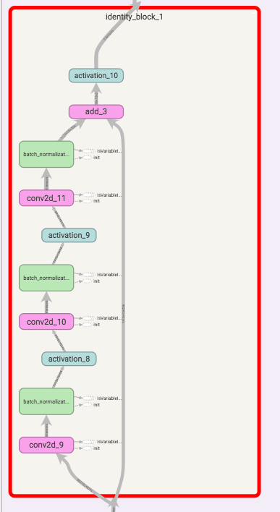
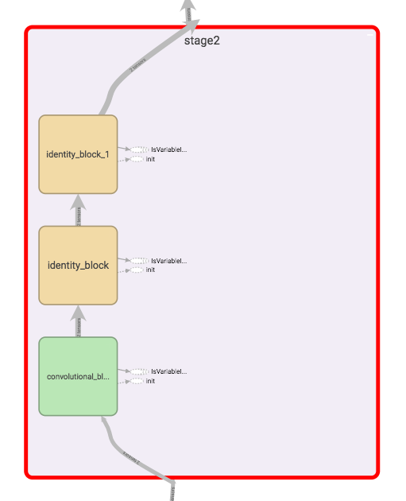
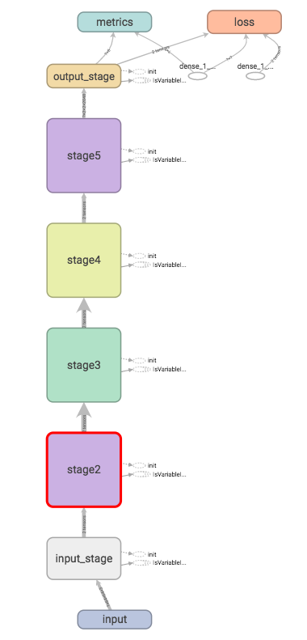
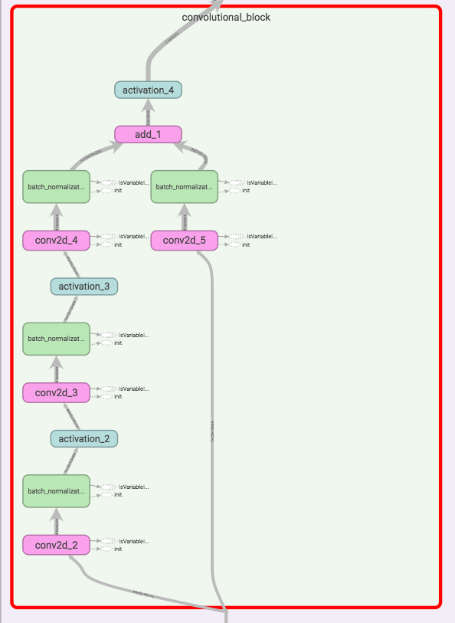
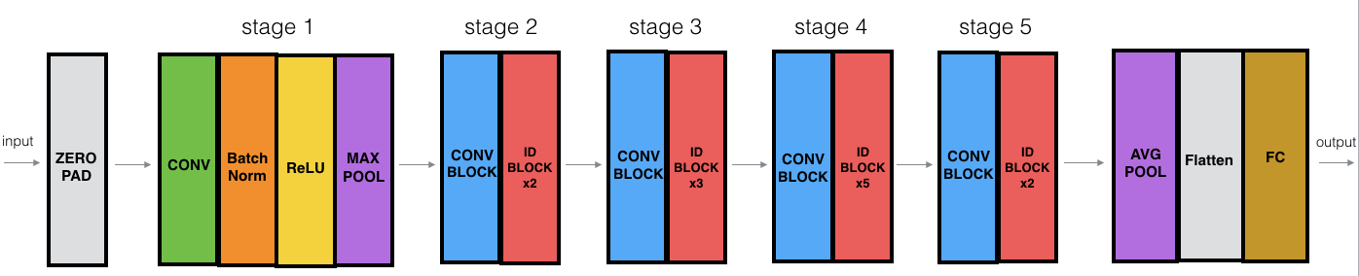
ResNet-50 neural network:

Slide 12
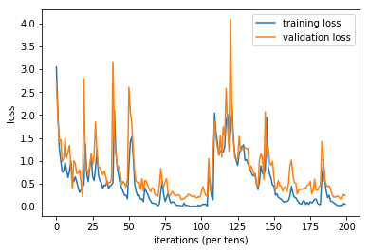
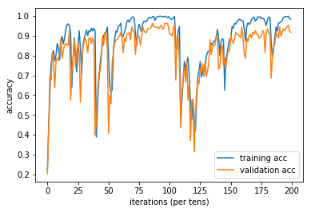
Evaluation
Good Point:
Speed of convergence becomes faster
When stable, the test accuracy is higher
Bad Point:
The training process is very unstable.
Problem:
How to improve stableness?
Guess:
Adjust hyperparameter( learning rates, batches…)?
Increase the number of epochs?
Increase dataset?
test loss
test acc
Test accuracy: 0.95

Slide 13
Outline
0. Background
Previous Work
2. ResNet-50 Model
3. Experiment
4. Future Work

Slide 14
Aiming for:
Designing a real-time human-computer interaction system based on hand gesture.
Consisting of:
Hand detection
use yolo(You Only Look Once) to detect the hand.
Gesture recognition
use the convolutional neural network (CNN) to recognize gestures
Human-computer interaction (HCI)

